Slide 1
Homework check!

Slide 2
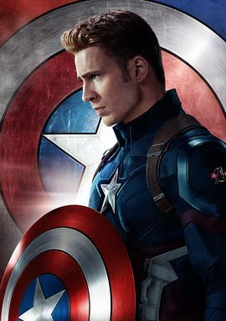
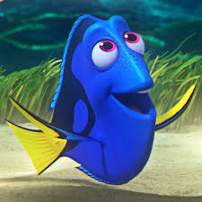
LO: How do I create a character with personality?

Slide 3
New vocabulary for today!
Callous (adjective) having a heartless and cruel disregard for others.
Example: It might sound callous, but I don’t care if he needs help.

Slide 4
LO: How do I create a character with personality?
Take a character from a film / TV programme that you know.
Change their name.
Place them (and their personality) in your story.

Slide 5
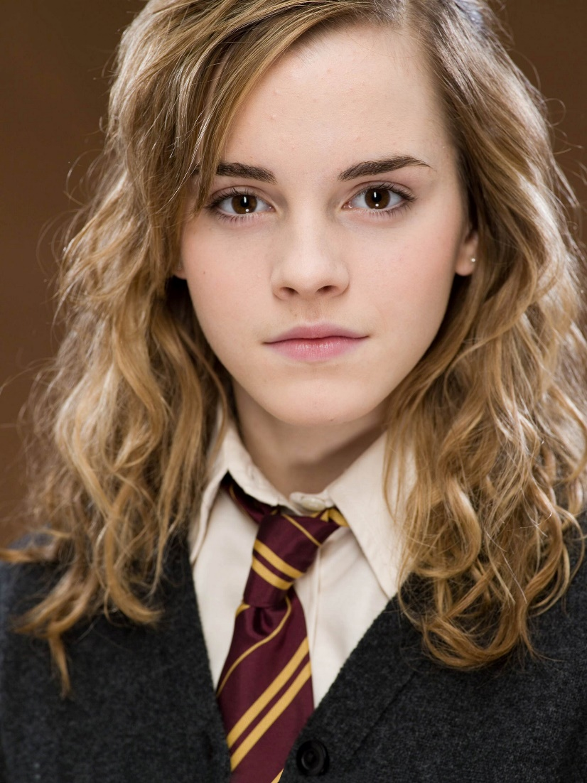
Choose a character from a book, film, TV show that you know well enough to describe how the behave, how they talk etc.
Hermione Granger
My name: Kate Don’t make the mistake of using silly names
Choose 3 words (or phrases) to describe how she acts / behaves

Slide 6
How would a character like Hermione behave when searching for something she’s lost
With an air of calm, Kate opened her bag…

Slide 7
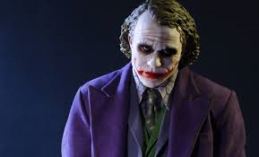
Choose a character from a book, film, TV show that you know well enough to describe how the behave, how they talk etc.
The Joker
My name: Jack Don’t make the mistake of using silly names
Choose 3 words to describe their personality.

Slide 8
The Joker waiting at a bus stop

Slide 9
The joker at the bus stop
He tapped his foot, again. Then growled as a young woman, carrying a baby, attempted to squeeze past him. His glare was enough to send her scurrying to the other corner of the bus shelter. Foot still tapping, he glanced at his watch. Another minute. Jack pushed forward. To his left an old man stumbled out of the way. To his right a school girl gasped, jumped aside, and glared over her shoulder.

Slide 10
Choose: Hermione or the Joker They are completing a really difficult piece of maths homework

Slide 11
LO: How do I create a character with personality?
Now choose your own character
Give them an ordinary name
Write 3 words to describe their personality

Slide 12
Ok. Think of another character.
Write their name. Give them a ‘ordinary’ name. Write 3 inner character traits.
Write them asking for directions.
Write them trying to get through the oyster turnstiles at the tube.
Write them looking for a box of cereal in the supermarket.

Slide 13
Plan a short story with the title “Lost”
Setting –
Events –
Other characters -

